Slide 1
Evaluation of large eddy simulation results of the Grey Zone cold air outbreak model intercomparison case
Stephan de Roode (TU Delft)
Thomas Frederikse (TU Delft)
Pier Siebesma (KNMI/TU Delft)
Harm Jonker (TU Delft)
Adrian Hill, Paul Field (UKMO)
Lorenzo Tomassini (MPI-Hamburg)
Jens Fricke (U. Hannover)
Akira Noda (Japan A.M-E.S.T)
Rachel Honnert (Meteo France)

Slide 2
Motivation: length scales and microphysics
low droplet concentration
high droplet concentration
DALES results by Thomas Frederikse

Slide 3
What to expect in this presentation?
* CONSTRAIN case description of the LES experiments
* What do we wish to learn?
* Mean state and fluxes during the cold air outbreak
* Scale dependency of fluxes and variances
* Conclusions

Slide 4
Constrain Case
January 31, 2010 12:53 UTC (Source: Met Office)

Slide 5
Constrain Case: Lagrangian LES experiment

Slide 6
SST

Slide 7
Large-scale subsidence

Slide 8
Questions
1. What is the effect of cloud droplet concentration and ice microphysics on the evolution of the Cold Air Outbreak?
2. What are the dominant length scales of the turbulent transport?
3. Diagnose dependency of NWP subgrid fluxes on grid size Δx
4. Run LES in a NWP model (coarse horizontal resolution)

Slide 9
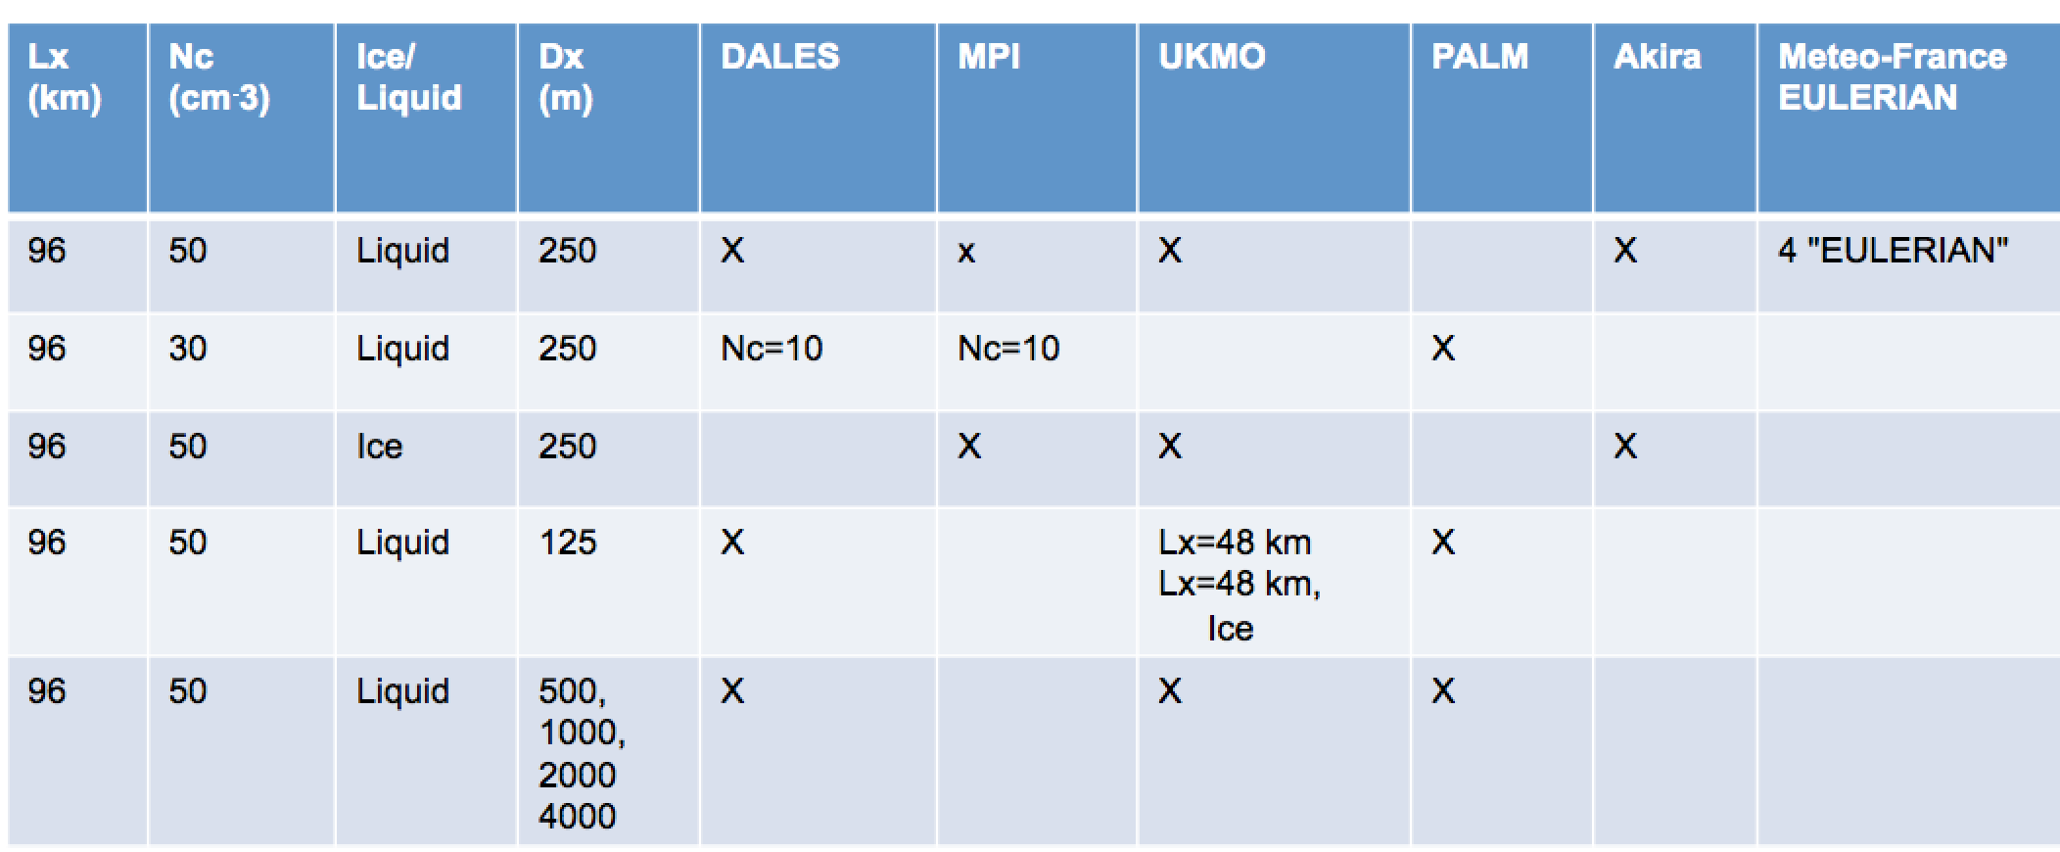
Summary of LES experiments
Reference
Low droplet con
Ice micro
High-res
"NWP" mode

Slide 10
Requested output
1. Time series of scalars
2. Vertical profiles
3. 3D fields

Slide 11
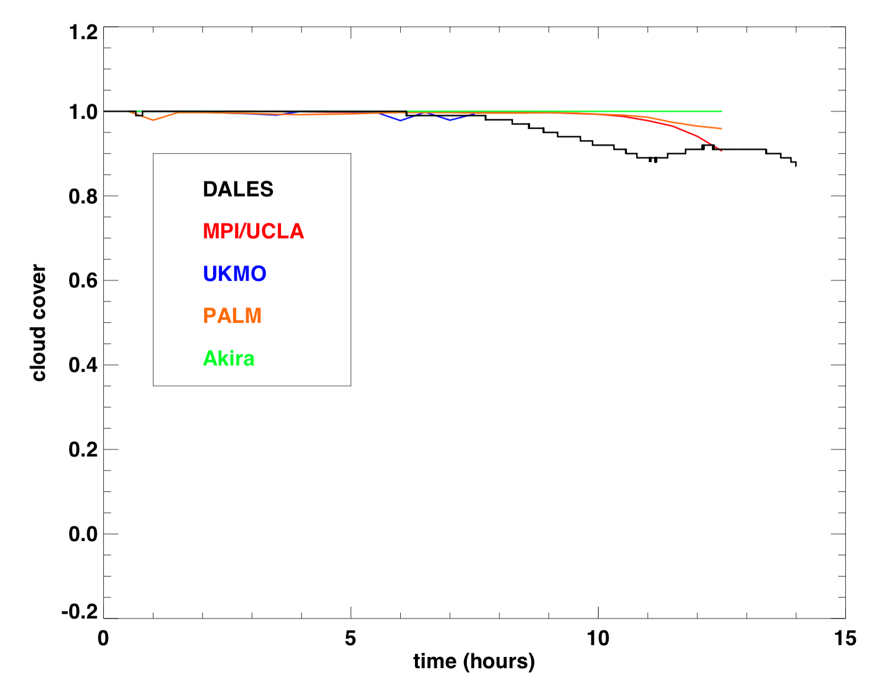
Cloud cover

Slide 12
Examples: LWP after 13 hours

Slide 13
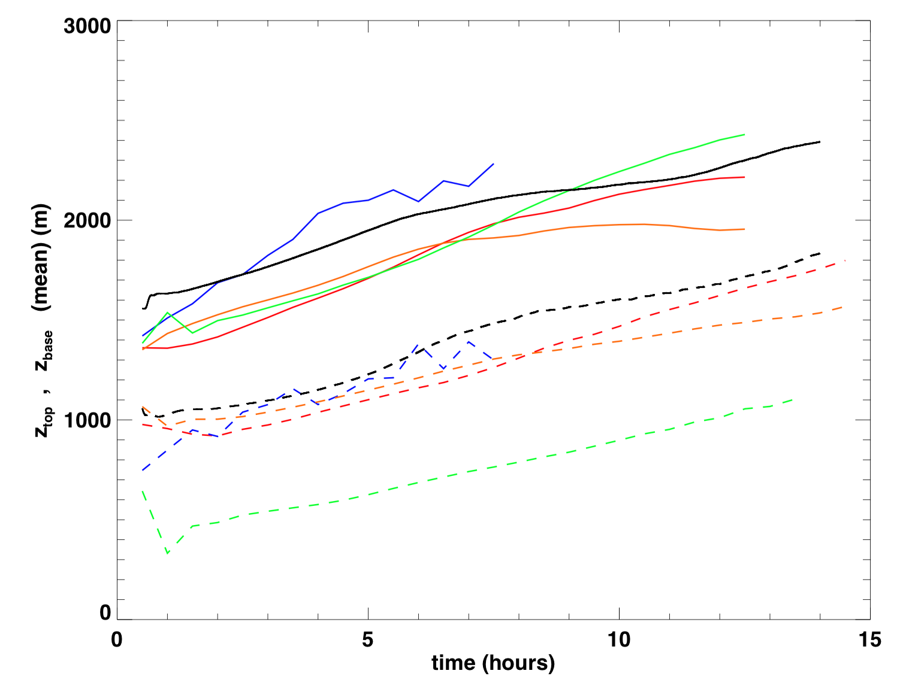
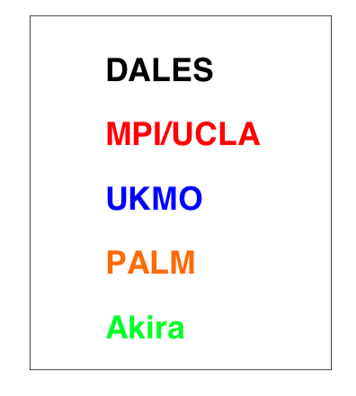
Cloud boundaries
Cloud top increases with time -> strong entrainment
Akira's LES gives much thicker cloud layer

Slide 14
Surface heat fluxes
* DALES results have used original forcings -> runs with updated forcings are still running
* PALM has no smooth interpolated SST
* UKMO has short run
* Usually requested output is not always present or in units different that requested
=> scale dependency of fluxes shows some robust features

Slide 15
Surface heat fluxes
* Akira's thick cloud layer may be related to very large latent heat fluxes

Slide 16
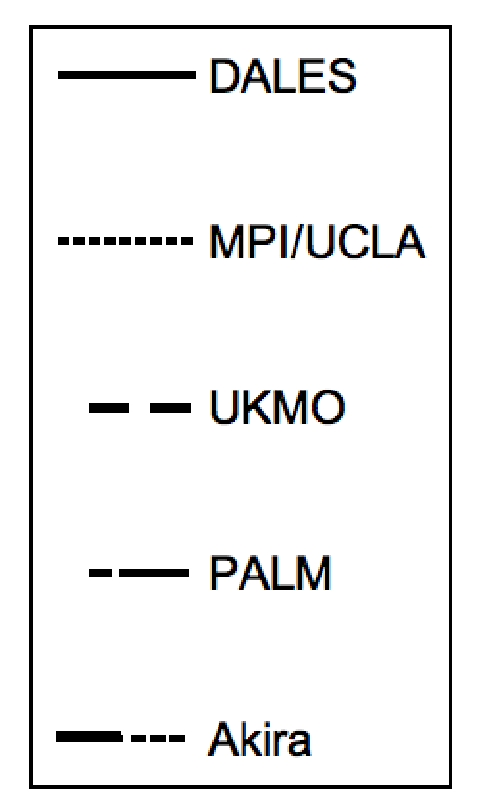
Mean state at t = 5 hours (black)
Mean state at t = 13 hours (red)
* at the end of simulation total water content not vertically well mixed
* DALES early cloud break-up: warmer and drier cloud layer

Slide 17
t = 5 hours (black)
t = 13 hours (red)
* u and v variance increase with time
* w variance develops signature of two layer turbulence structure

Slide 18
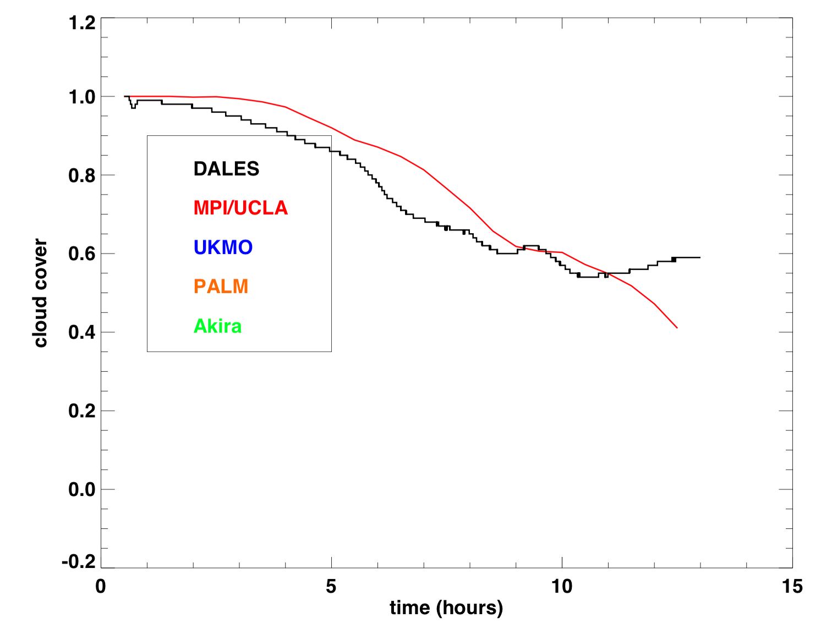
Reduce cloud droplet concentration to 10 cm⁻³
* much more rapid break-up

Slide 19
Reduce cloud droplet concentration to 10 cm⁻³
Nc = 50 cm⁻³
Nc = 10 cm⁻³
* with lower droplet concentration less LWP and finer cloud structures

Slide 20
Reduce cloud droplet concentration to 10 cm⁻³
* much more rapid break-up

Slide 21
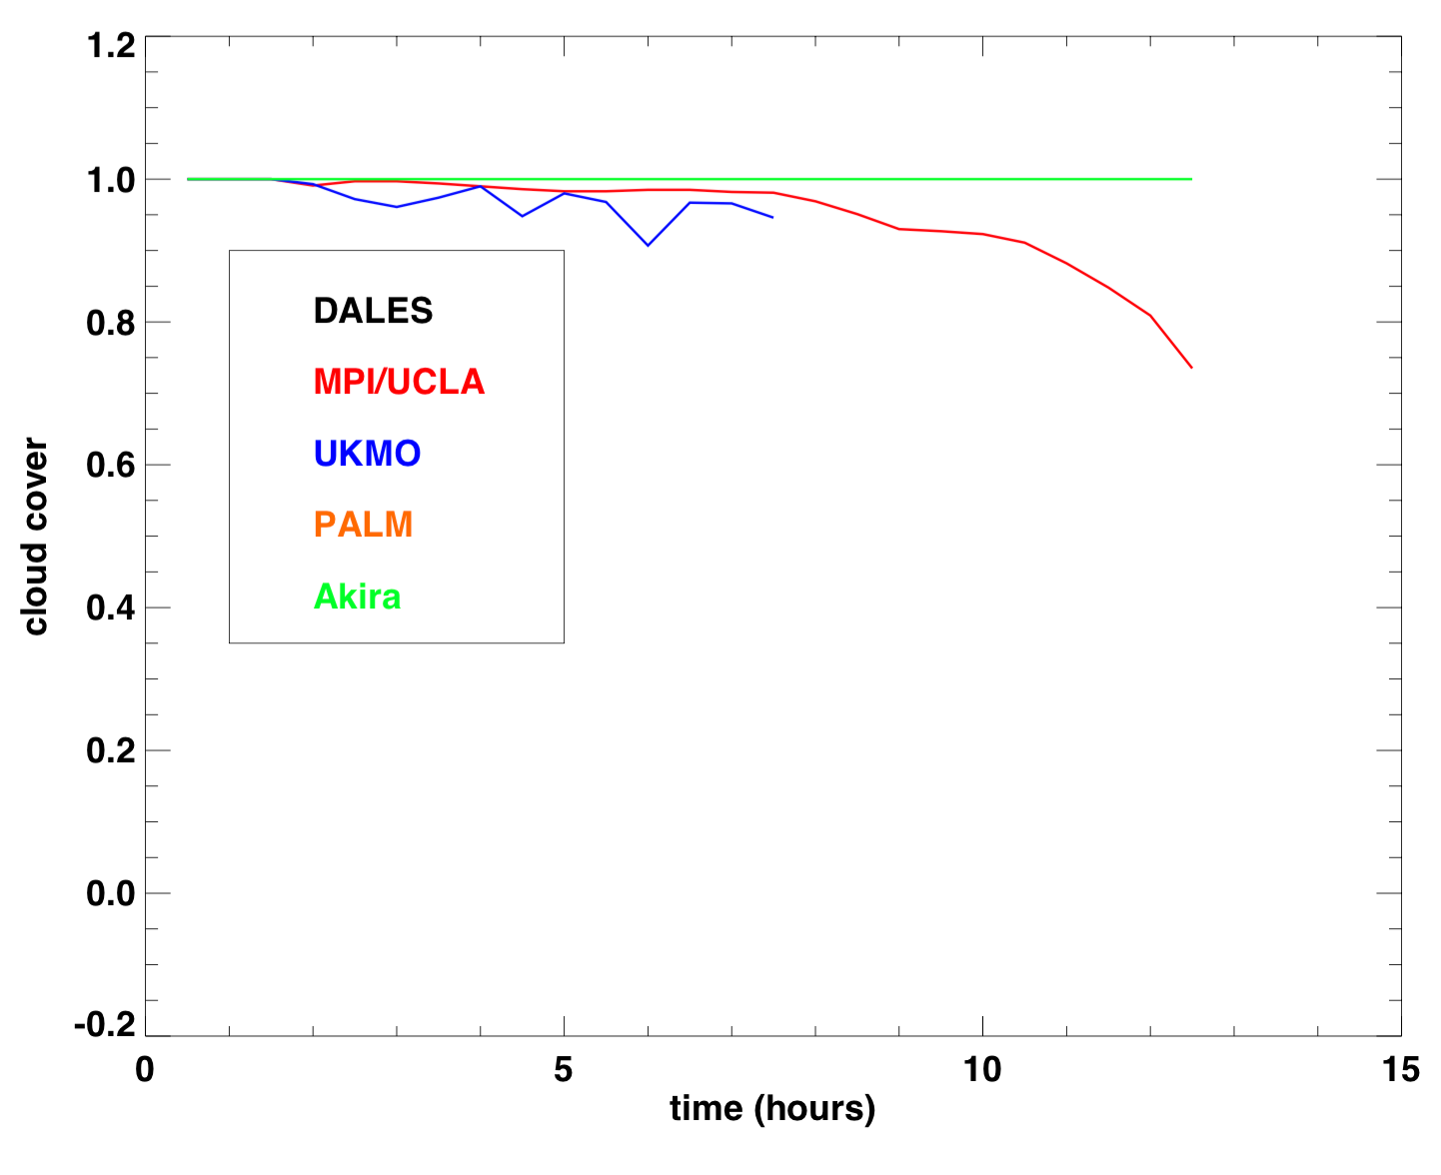
Effect of including ice microphysics
reference
liquid only
ice microphysics

Slide 22
Some examples of large-scale structures for reference case
qt and thl at mid-cloud, t=13 hrs
* qt and LWP very strongly correlated

Slide 23
Some examples of large-scale structures for reference case
u and v at mid-cloud, t=13 hrs
mid subcloud =>
* notice u,v range (min-max 10 m/s)
* "rings" of downdrafts and updrafts

Slide 24
Spectral evolution in DALES

Slide 25
Spectral analysis, mid-cloud, t=13 hrs
100
10
1
0.1 km
100
10
1
0.1 km
v-velocity
w-velocity
MPI/UCLA
PALM
Akira

Slide 26
Spectral analysis, mid-cloud, t=13 hrs
100
10
1
0.1 km
100
10
1
0.1 km
MPI/UCLA
PALM
Akira

Slide 27
Spectral analysis, mid-cloud, t=13 hrs
100
10
1
0.1 km
100
10
1
0.1 km
MPI/UCLA
PALM
Akira
Akira: u and w at same
grid location in 3D fields?

Slide 28
Turbulent/convective flux in traditional NWP
zero for sufficiently large Δx

Slide 29
Turbulent/convective flux in very high resolution NWP
becomes non-zero for sufficiently fine Δx

Slide 30
Turbulent/convective flux in very high resolution NWP
becomes non-zero for sufficiently fine Δx
should reduce accordingly

Slide 31
Turbulent/convective flux in very high resolution NWP
becomes non-zero for sufficiently fine Δx
should reduce accordingly
Diagnose resolved and subgrid flux from LES fields as a function
of the horizontal grid size Δx that the NWP would use

Slide 32
Resolved and subgrid vertical velocity variance (mid-cloud)
subgrid = dashed
Akira
PALM
MPI

Slide 33
Resolved and subgrid vertical velocity variance (mid-cloud)
Akira
MPI
PALM
resolved =solid
MPI/UCLA
PALM
Akira

Slide 34
Resolved and subgrid qtot variance (mid-cloud)
subgrid = dashed
Akira
PALM
MPI

Slide 35
Resolved and subgrid vw flux (mid-cloud)
subgrid = dashed
MPI
PALM
Akira

Slide 36
Run LES on a coarse horizontal resolution
DALES Δx = 1600m

Slide 37
Run LES on a coarse horizontal resolution
DALES Δx = 1600m

Slide 38
Conclusions
Microphysics:
Cloud break up earlier for low cloud droplet concentration
Scales:
qualitative agreement on scale growth from LES results
turbulent fluxes become resolved for Δx<10 km

Slide 39
To do
All: provide data if figures presented here are missing your results
DALES: new runs with forcing
MPI: include coarse resolution LES runs
PALM: correct SST
UKMO: longer runs?
Akira: LHF , location variables at grid

Slide 40
Questions
1. What is the effect of cloud droplet concentration and ice microphysics on the evolution of the Cold Air Outbreak?
2. What are the dominant length scales of the turbulent transport?
3. Diagnose dependency of NWP subgrid fluxes on grid size Δx
4. Run LES in a NWP model (coarse horizontal resolution)

Slide 41
What to expect in this presentation?
* Why LES of a cold air outbreak?
* Case description and LES experiments
* Science Questions, or what do we wish to learn?
* Mean state and fluxes during the cold air outbreak
* scale dependency of fluxes
Conclusions
Why LES of a cold air outbreak?
Case description and LES experiments
Science Questions, or what do we wish to learn?
Mean state, fluxes, scale dependency of fluxes
Conclusions

Slide 42
What to expect in this presentation?

