Slide 1
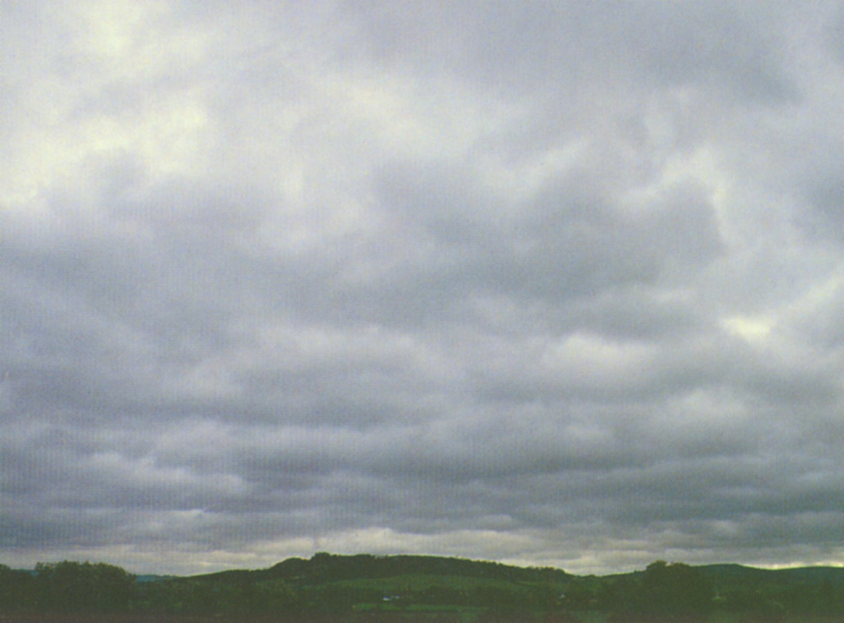
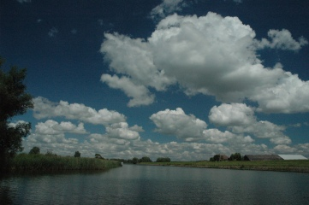
Low clouds in the atmosphere:
Never a dull moment
stratocumulus
cumulus
Stephan de Roode (GRS)

Slide 2
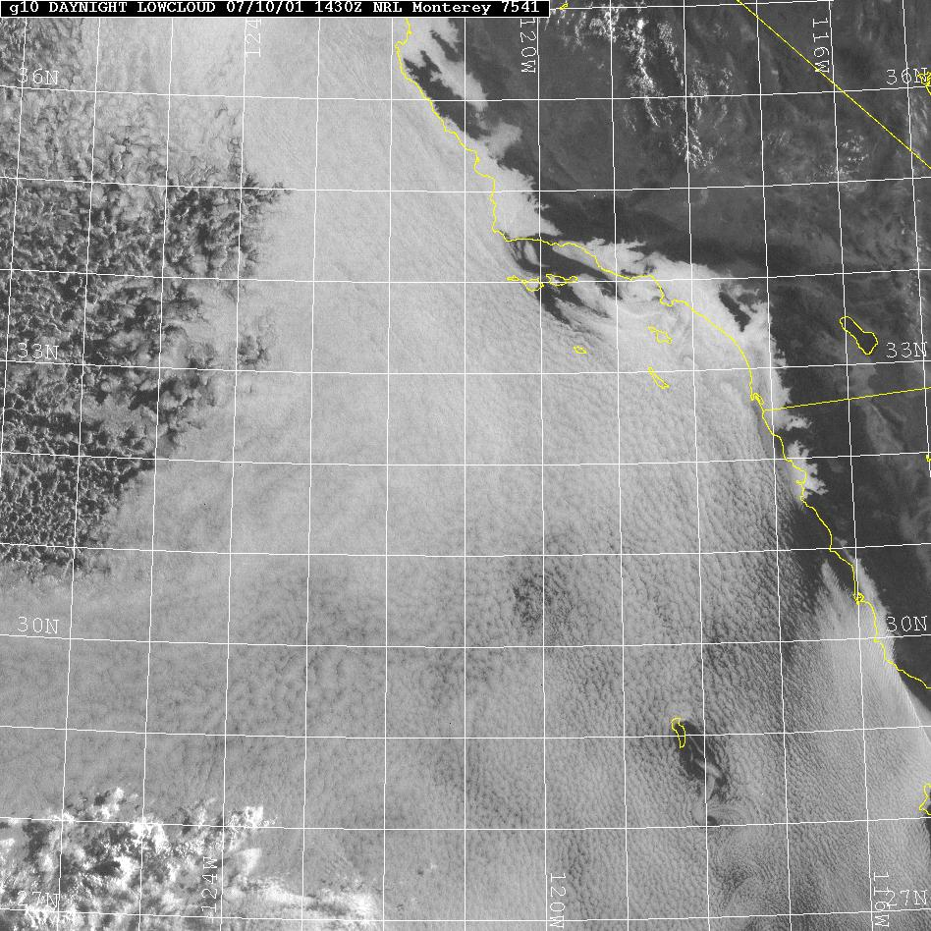
Stratocumulus off the coast of California
1100 km
1100 km

Slide 3
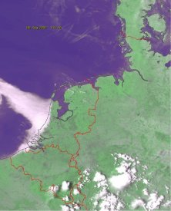
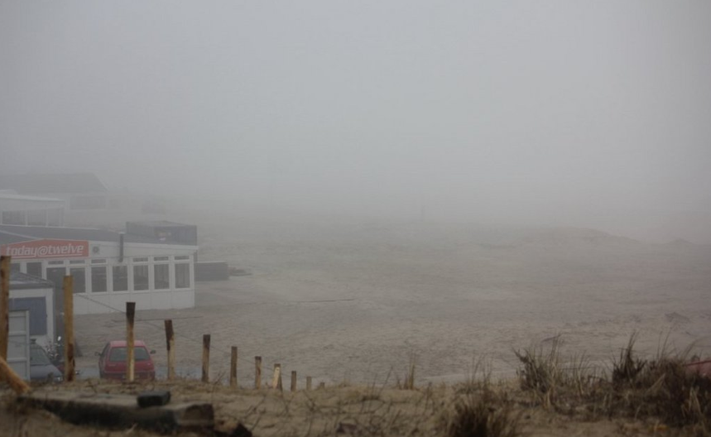
Low clouds above the North Sea (and a part of the coast)

Slide 4
Outstanding questions
1. Stratocumulus and climate change
Randall et al. 1984:
"A 4% increase in global stratocumulus extend would offset 2-3K global warming from CO2 doubling"
cloud layer geometric thickness [m]

Slide 5
Outstanding questions/problems
2. Poor representation of stratocumulus in weather forecast models
Stevens et al. 2007:
"ECMWF products are more deficient in their representation of the stratocumulus topped boundary layer itself...... cloud liquid water paths still tend to be a factor of 2–4 less than observed, and boundary layer temperatures are found to correlate poorly with the observations."
* Can we improve the prediction with a high-resolution model?

Slide 6
Contents
* Stratocumulus formation
* Stratocumulus climate feedback
* High-resolution modeling of stratocumulus

Slide 7
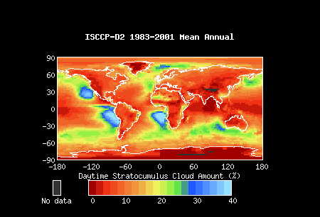
Global stratocumulus amount

Slide 8

Necessary ingredients for stratocumulus formation
high pressure area &
cold surface water

Slide 9
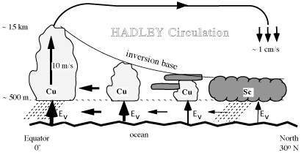
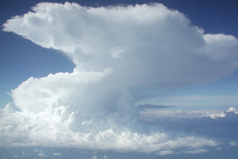
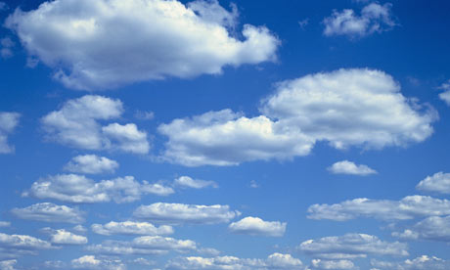
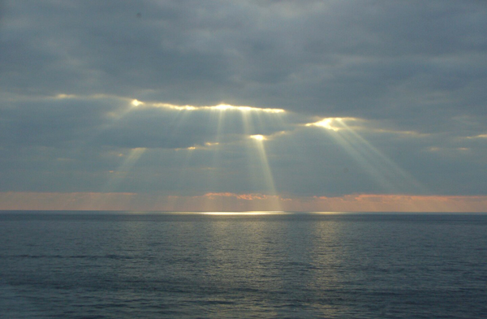
Stratocumulus frequently present in the subsiding branch of Hadley circulation
warm and dry
cold and moist
deep convection
shallow cumulus
stratocumulus

Slide 10
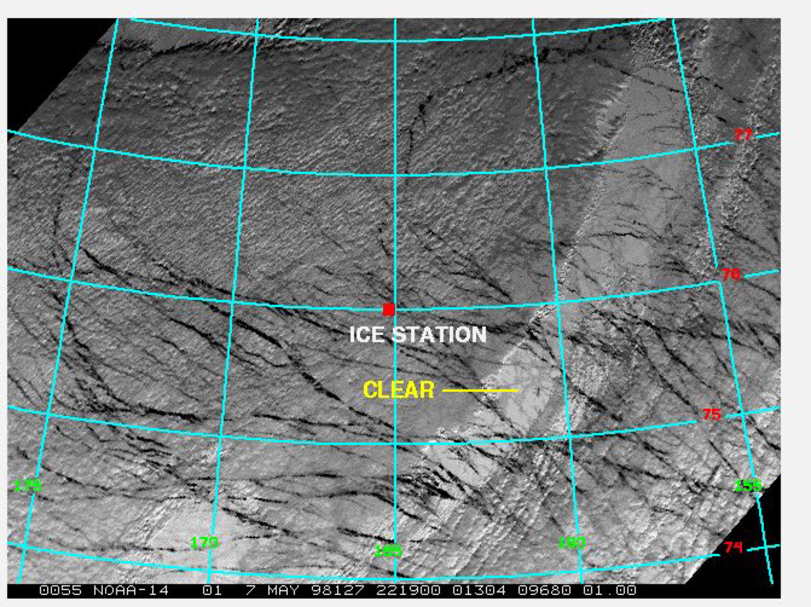
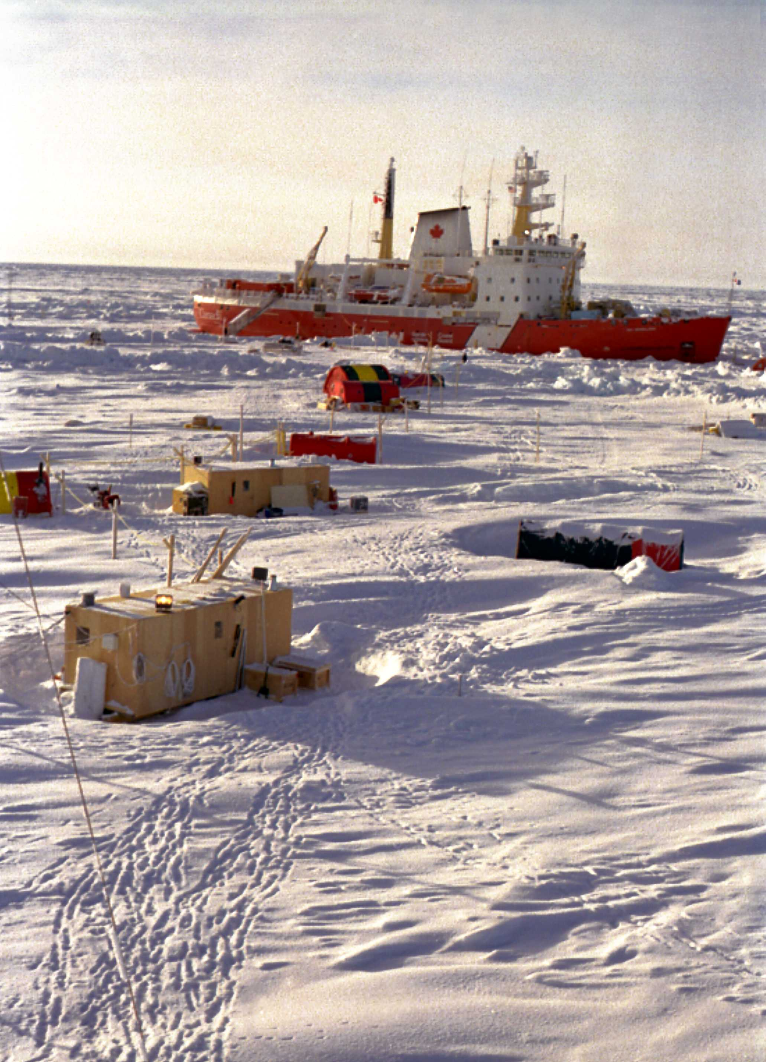
Stratocumulus frequently present in the Arctic area
(but we can hardly observe them from satellite)
Infrared: very low thermal contrast between ice surface and low clouds
Shortwave: albedo ice and cloud similar (and long dark winters)

Slide 11
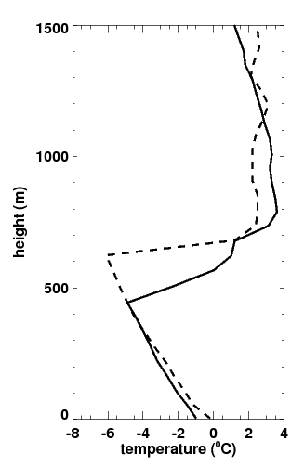
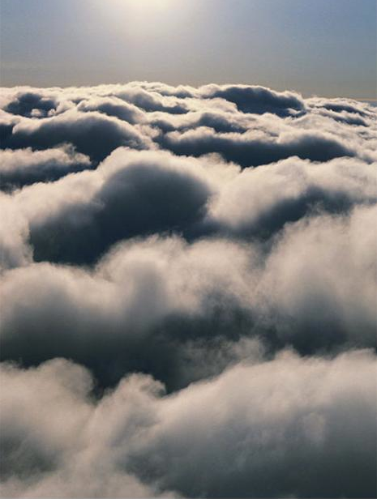
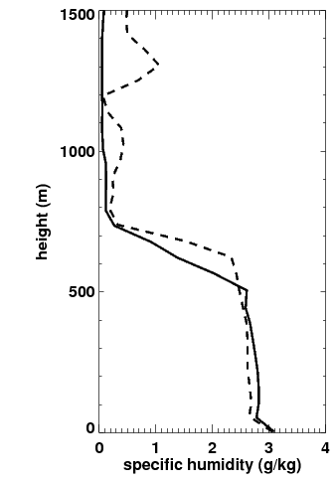
Stratocumulus clouds, 31 January 2011
Radiosonde observations for De Bilt
00 UTC
12 UTC
31 January 2011
Sharp inversion layer structure cannot be captured by weather forecast models

Slide 12
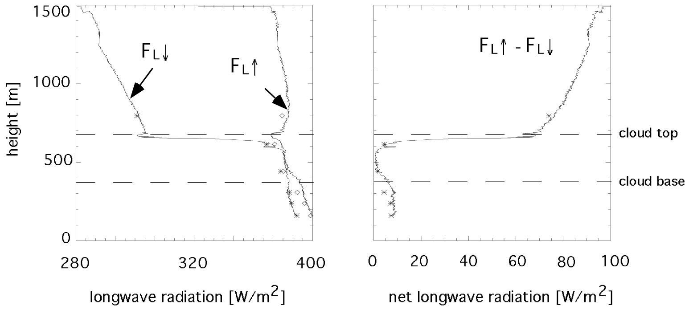
Longwave radiative cooling at the cloud top
Duynkerke et al. (1995)
radiative cooling tendency at cloud top ~ -8 K/hr

Slide 13
Turbulence causes entrainment of warm and dry inversion air into the cloud layer

Slide 14

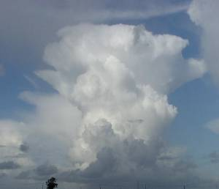
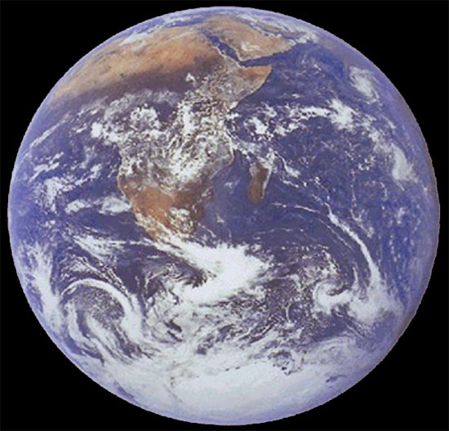
Atmospheric Models
Cloud dynamics
mm
10 m
100 m
1 km
10 km
100 km
1000 km
10000 km
Cloud microphysics
⬅
turbulence
Cumulus
clouds
Cumulonimbus
clouds
Mesoscale
Convective systems
Extratropical
Cyclones
Planetary
waves
DNS
Subgrid
Large Eddy Simulation (LES) Model
Limited Area Weather Model (LAM)
Numerical Weather Prediction (NWP) Model
Global Climate Model
Fundamental
Engineering
Slide courtesy Harm Jonker and Pier Siebesma

Slide 15
Current developments
Cloud dynamics
mm
10 m
100 m
1 km
10 km
100 km
1000 km
10000 km
Cloud microphysics
⬅
turbulence
Cumulus
clouds
Cumulonimbus
clouds
Mesoscale
Convective systems
Extratropical
Cyclones
Planetary
waves
DNS
Subgrid
Large Eddy Simulation (LES) Model
Limited Area Weather Model (LAM)
Numerical Weather Prediction (NWP) Model
Global Climate Model
Fundamental
Engineering

Slide 16
Feedback effects in a changing climate
Cloud feedback
Surface albedo feedback
Water vapor feedback
Radiative effects only
Dufresne & Bony, Journal of Climate 2008

Slide 17
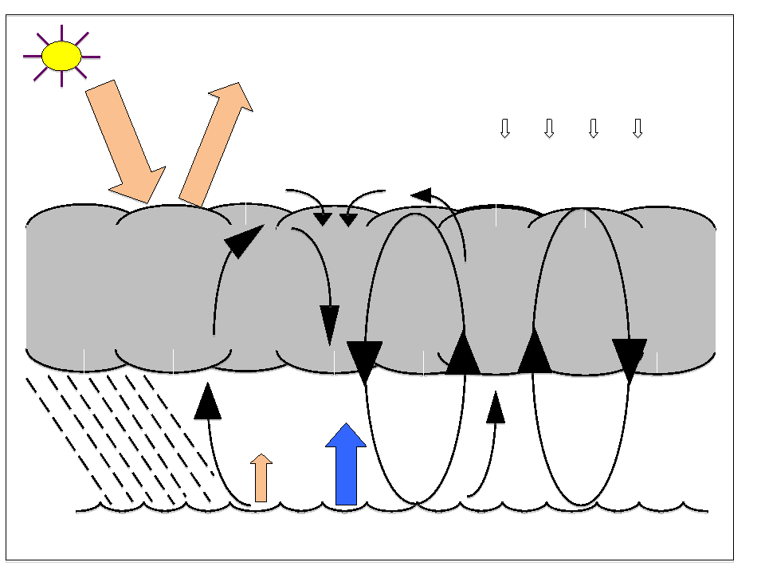
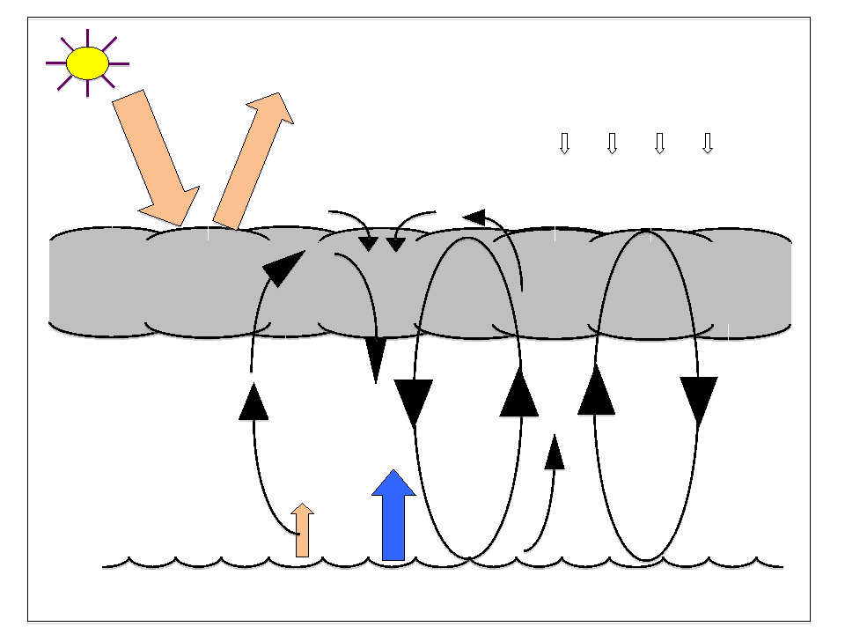
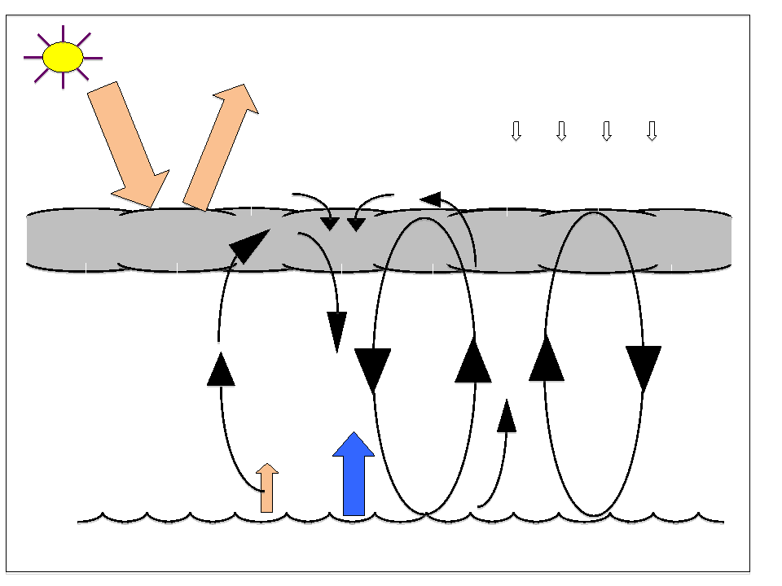
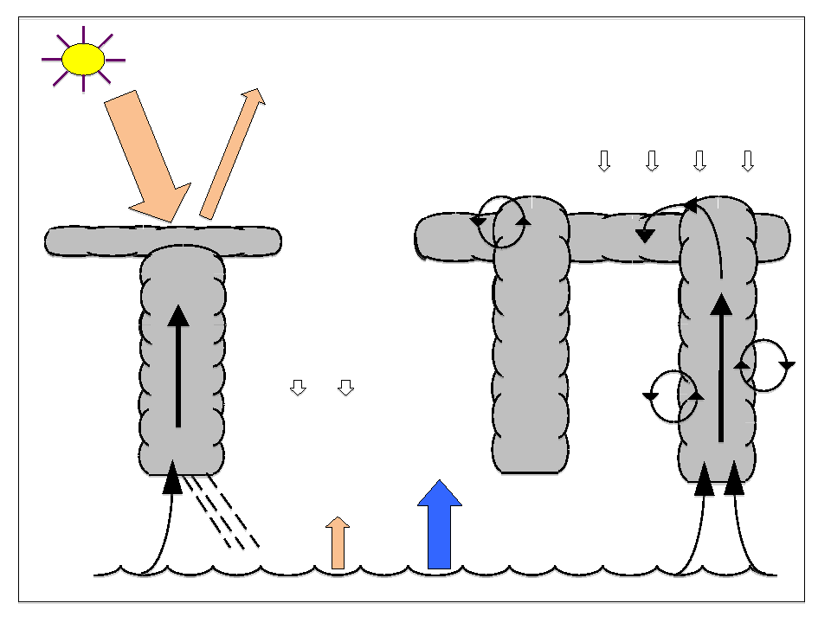
Present
Perturbed Future
Neg. Feedback
Pos. Feedback
Strong Pos. Feedback
slide Pier Siebesma

Slide 18
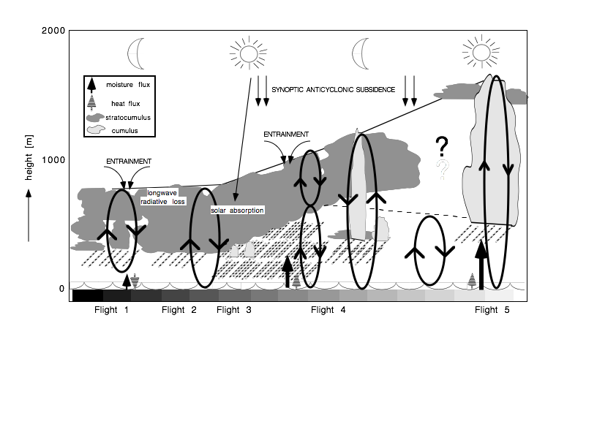
Can models faithfully represent low clouds?
Simulations of the ASTEX Lagrangian stratocumulus experiment

Slide 19
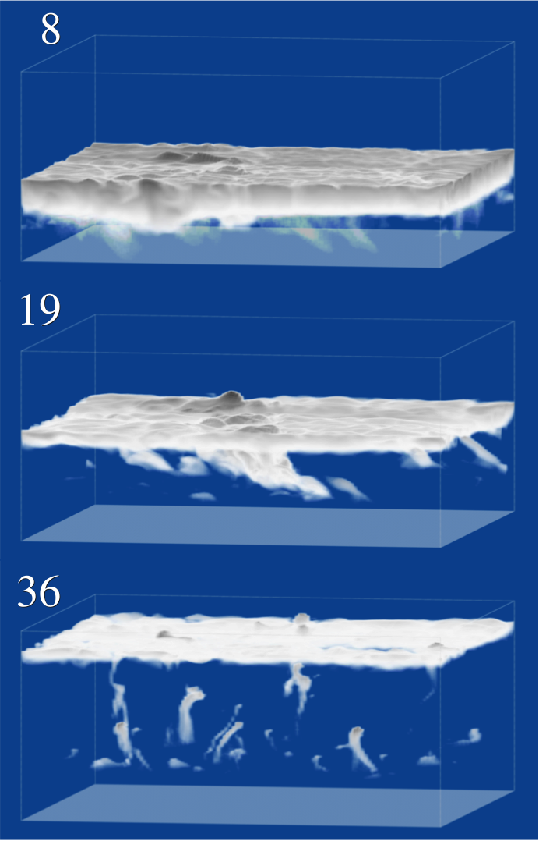
Modeling results for ASTEX case
Case set-up based on De Roode and Duynkerke (1997)
20 international institutions participate in this model intercomparison case
Van der Dussen et al. (2012)

Slide 20
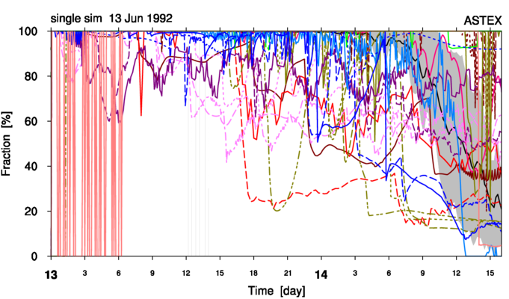
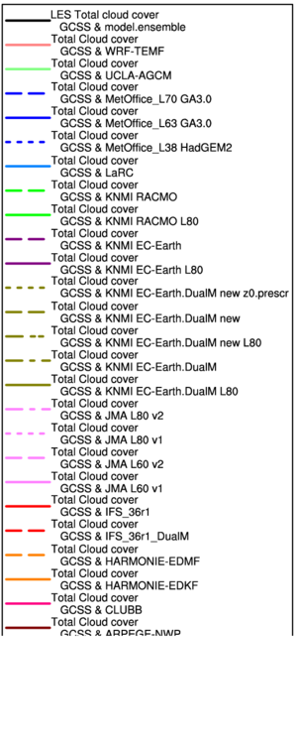
Results of single-column model versions of climate models: cloud fraction
Plot by Roel Neggers (KNMI)

Slide 21
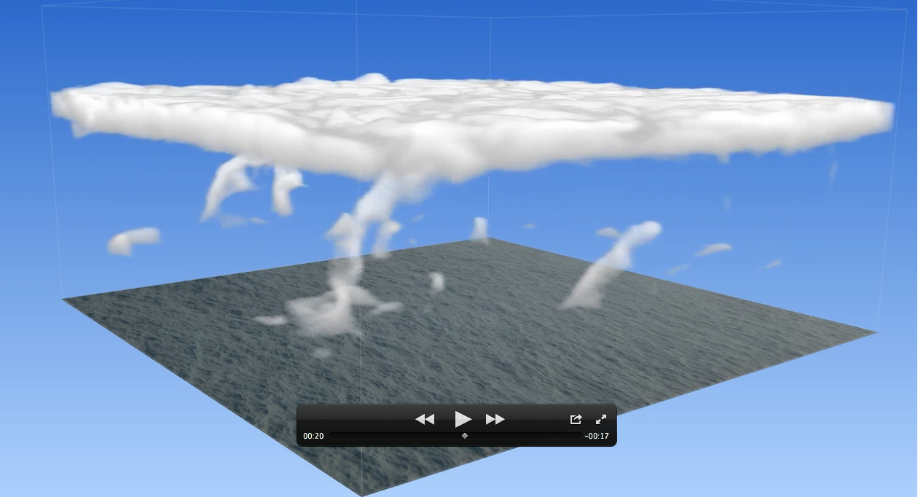
What did we learn from the Lagrangian transition?
Movie by Johan van der Dussen

Slide 22
The CGILS project (Zhang et al. 2013)
S6
cumulus
S11 cumulus under stratocumulus
S12
stratocumulus
Equilibrium states are computed for three selected columns in the Hadley circulation
* Single-column model (SCM) versions of climate models
* Large-eddy simulation (LES) models
Run to steady state with diurnally-averaged insolation
Vertical profiles of temperature, humidity and ozone above the LES domain are used for radiative transfer

Slide 23
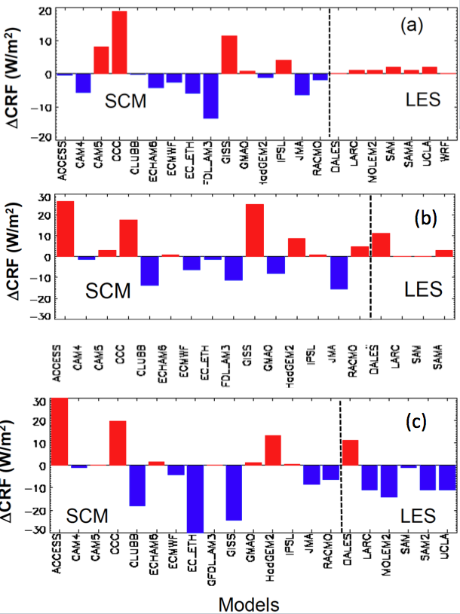
Cloud Radiative Feedback (CRF) if the large-scale forcing is perturbed (higher sea surface temperature)
S12
stratocumulus
red =
positive feedback
blue=
negative feedback
S11 cumulus under stratocumulus

Slide 24

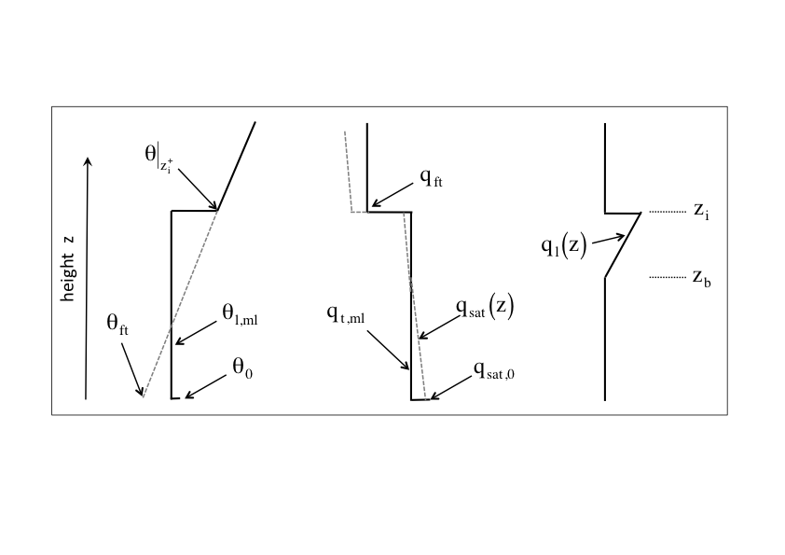
"phase space” experiments with a conceptual model: how do inversion jumps control equilibrium solutions?
0 = surface flux + entrainment flux - source

Slide 25
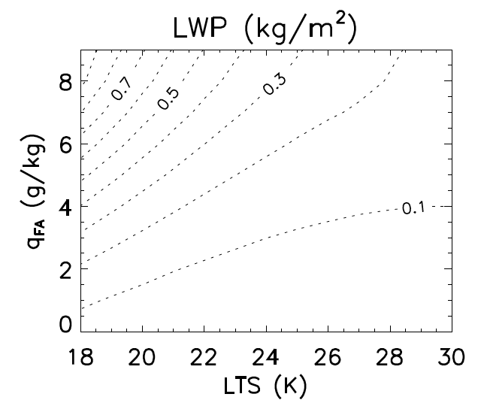
Liquid water path (LWP) response to a perturbation in the sea surface temperature θ₀
more humid inversion layer
warmer inversion layer
De Roode et al. (2013)

Slide 26
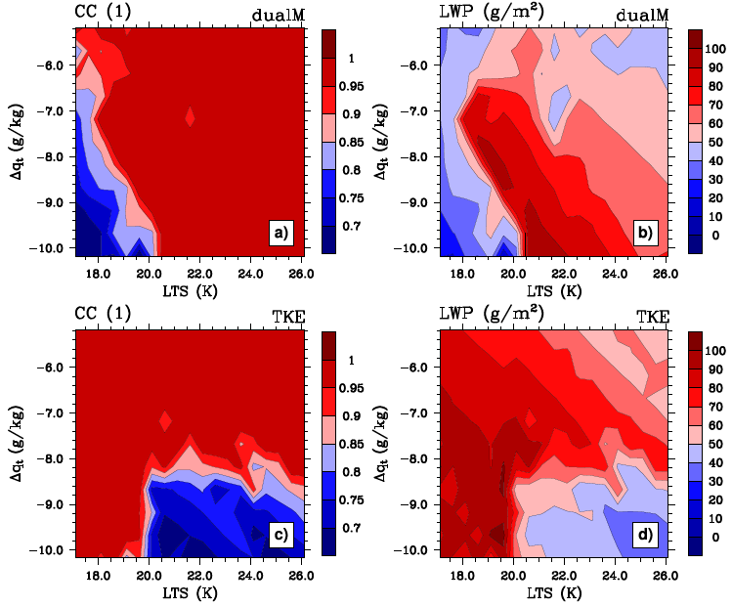
Cloud regimes: Results from two different transport schemes used in weather and climate models ("dualM" and "TKE")
cloud cover CC
liquid water path LWP
Dal Gesso et al. (2013)

Slide 27
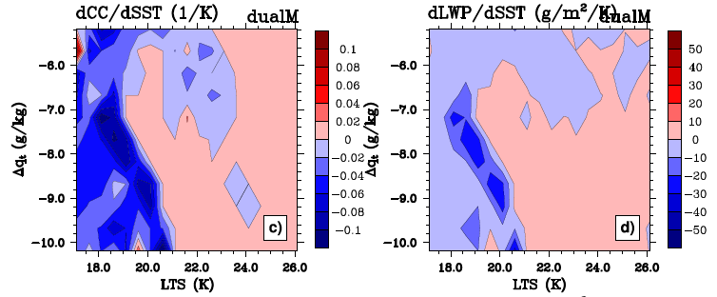
Cloud response to warming of atmosphere
cloud cover (CC) liquid water path (LWP)
more humid inversion layer
warmer inversion layer
Dal Gesso et al. (manuscript in preparation)

Slide 28
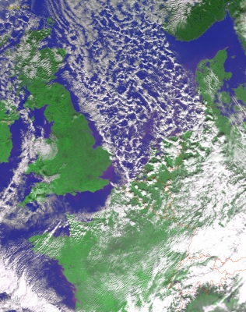
Cold air outbreak
mean wind
Satellite

Slide 29
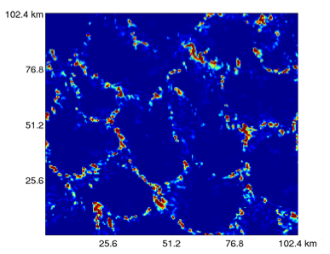

Cold air outbreak case simulated with the LES model
simulated cloud liquid water path (kg/m²)
Thomas Frederikse (MSc student)
MSc thesis defense: Tuesday 2 April, 15.00 pm

Slide 30
Summary
Physics of stratocumulus
Small scale processes (longwave radiation, entrainment across thin inversion layer)
Weather forecast models
Have a coarse vertical resolution causing difficulties to capture small-scale processes
High-resolution large-eddy simulation models
Invaluable tool for studying dynamics of stratocumulus
Ambition: Detailed weather prediction for wind and solar energy
Current model intercomparison projects
Phase space experiments, cold air outbreak

